Slide 1

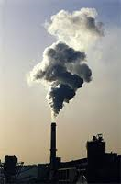
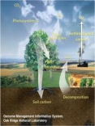
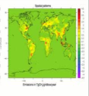



Global Methane Budget
2020
The Global Methane budget for 2000-2017
The GCP is a Global Research Project of
and a Research Partner of
Published on 15 July 2020
PowerPoint version 1.0 (released 15 July 2020)

Slide 2
Acknowledgements
The work presented here has been possible thanks to the enormous observational and modeling efforts of the institutions and networks below
Atmospheric CH₄ datasets
NOAA/ESRL (Dlugokencky et al., 2011)
AGAGE (Rigby et al., 2008)
CSIRO (Francey et al., 1999)
UCI (Simpson et al., 2012)
Top-down atmospheric inversions
CarbonTracker-Europe CH₄ (Tsuruta et al., 2017)
GELCA (Ishizawa et al., 2016)
LMDz-SACS- PYVAR (Zheng et al., 2018a; 2018b;Yin et al., 2015)
MIROC4-ACTM (Patra et al., 2016; 2018)
NICAM-TM (Niwa et al., 2017b;2017b)
TM5-4DVAR (Houweling et al., 2014)
NIES-TM- Flexpart (Maksyutov et al., 2020; Wang et al., 2019a)
TM5-CAMS (Pandey et al., 2016; Segers and Houwelling, 2018)
TM5-4DVAR (Bergamaschi et al., 2013;2018)
Bottom-up modeling
Description of models contributing to the Chemistry Climate Model Initiative (CCMI) (Morgenstern et al., 2017)
Description of OH fields from CCMI (Zhao et al., 2019)
Bottom-up studies data and modeling
CLASS-CTEM (Arora et al. 2018; Melton and Arora, 2016)
DLEM (Tian et al., 2010;2015)
ELM (Riley et al., 2011)
JSBACH (Kleinen et al., 2019)
JULES (Hayman et al., 2014)
LPJ-GUESS (McGuire et al., 2012)
LPJ-MPI (Kleinen et al., 2012)
LPJ-wsl (Zhang et al., 2016)
LPX-Bern (Spahni et al., 2011)
ORCHIDEE (Ringeval et al., 2011)
TEM-MDM (Zhuang et al., 2004)
TRIPLEX-GHG (Zhu et al., 2104; 2015)
VISIT (Ito ad Inatomi, 2012)
FINNv1.5 (Wiedinmyer et al., 2011)
GFASv1.3 (Kaiser et al., 2012)
GFEDv4.1s (Giglio et al., 2013)
QFEDv2.5 (Darmenov and da Silva, 2015)
CEDS (Hoesly et al., 2018)
IIASA GAINS ECLIPSEv6 (Höglund-Isaksonn, 2012)
EPA, 2012
EDGARv4..3.2FT (Janssens-Maenhout et al. 2019)
FAO (Tubiello et al., 2013; 2019)
Full references provided in Saunois et al. 2020, ESSD

Slide 3
Contributors: 91 people | 69 organisations | 15 countries
Scientific contributors : Marielle Saunois France | Ann R. Stavert Australia | Ben Poulter USA | Philippe Bousquet France | Josep G. Canadell Australia | Robert B. Jackson USA | Peter A. Raymond USA | Edward J. Dlugokencky USA | Sander Houweling The Netherlands | Prabir K. Patra Japan | Philippe Ciais France | Vivek K. Arora Canada | David Bastviken Sweden | Peter Bergamaschi Italy | Donald R. Blake USA | Gordon Brailsford New Zealand | Lori Bruhwiler USA | Kimberly M. Carlson USA | Mark Carrol USA | Simona Castaldi Italy | Naveen Chandra Japan | Cyril Crevoisier France | Patrick Crill Sweden | Kristofer Covey USA | Charles Curry Canada | Giuseppe Etiope Italy | Christian Frankenberg USA | Nicola Gedney UK | Michaela I. Hegglin UK | Lena Höglund-Isaksson Austria | Gustaf Hugelius Sweden | Misa Ishizawa Japan | Akihiko Ito Japan | Greet Janssens-Maenhout Italy | Katherine M. Jensen USA | Fortunat Joos Switzerland | Thomas Kleinen Germany | Paul Krummel Australia| Ray Langenfelds Australia | Goulven G. Laruelle Belgium | Licheng Liu USA | Toshinobu Machida Japan | Shamil Maksyutov Japan | Kyle C. McDonald USA | Joe Mc Norton UK | Paul A. Miller Sweden | Joe R. Melton Canada | Isamu Morino Japan | Jurek Müller Swizterland | Fabiola Murguia-Flores UK | Vaishali Naik USA | Yosuke Niwa Japan | Sergio Noce Italy | Simon O’Doherty UK | Robert J. Parker UK | Changhui Peng Canada | Shushi Peng China | Glen P. Peters Norway | Catherine Prigent France | Ronald Prinn USA | Michel Ramonet France | Pierre Régnier Belgium | William J. Riley USA | Judith A. Rosentreter Australia | Arjo Segers The Netherlands | Isobel J. Simpson USA | Hao Shi USA | Steven J. Smith USA | Paul Steele Australia | Brett F. Thornton Sweden | Hanqin Tian USA | Yasunori Tohjima Japan | Francesco N. Tubiello Italy | Aki Tsuruta Finland | Nicolas Viovy France | Apostolos Voulgarakis UK | Thomas S. Weber USA | Michiel van Weele The Netherlands | Guido van der Werf The Netherlands | Ray Weiss USA | Doug Worthy Canada | Debra B. Wunch Canada | Yi Yin USA | Yukio Yoshida Japan | Wenxin Zhang Sweden | Zhen Zhang USA | Yuanhong Zhao France | Bo Zheng France | Qing Zhu USA | Qiuan Zhu China | Qianlai Zhuang USA |
Data visualisation support at LSCE : Patrick Bröckmann France | Cathy Nangini Canada

Slide 4
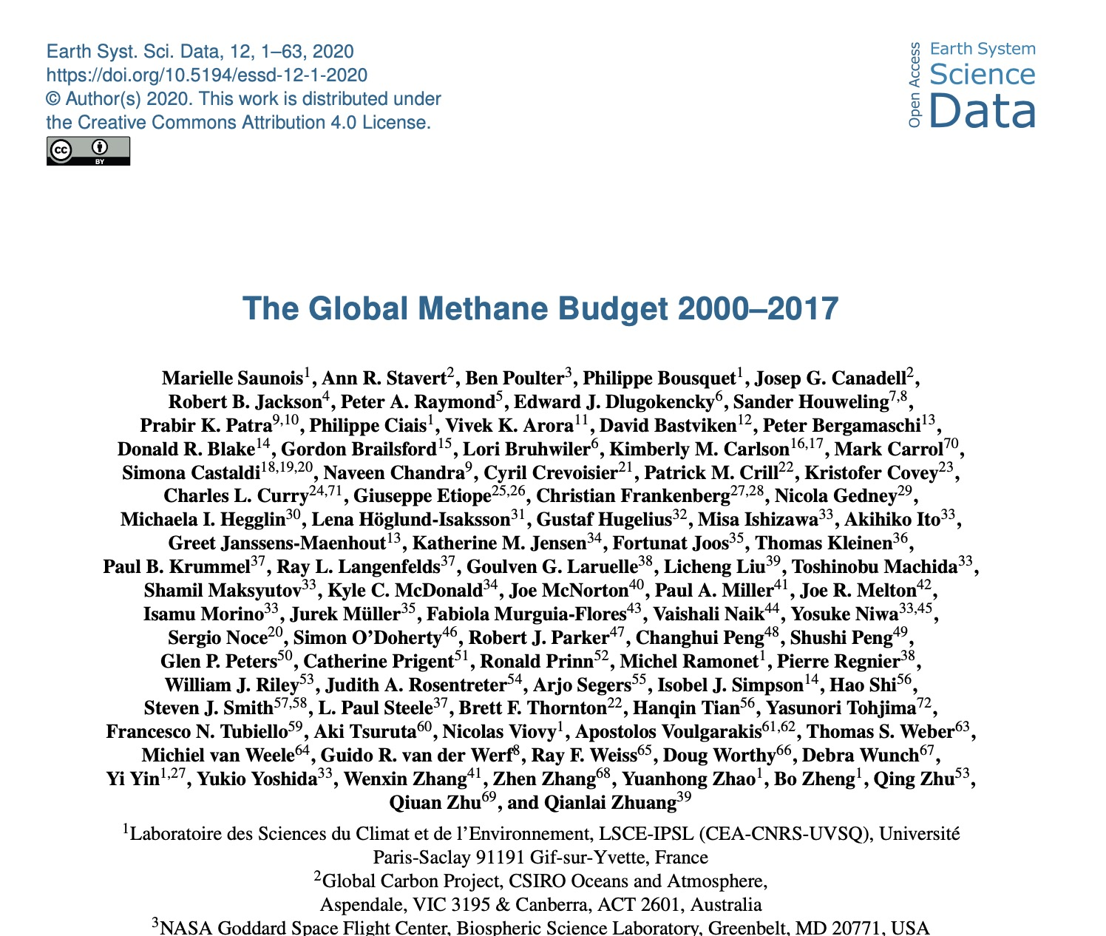
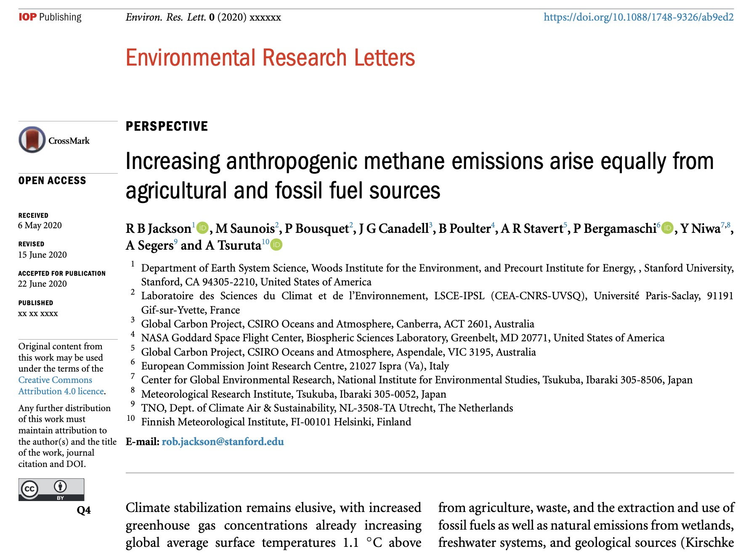
Publications
https://doi.org/10.5194/essd-12-1561-2020
https://doi.org/10.1088/1748-9326/ab9ed2

Slide 5
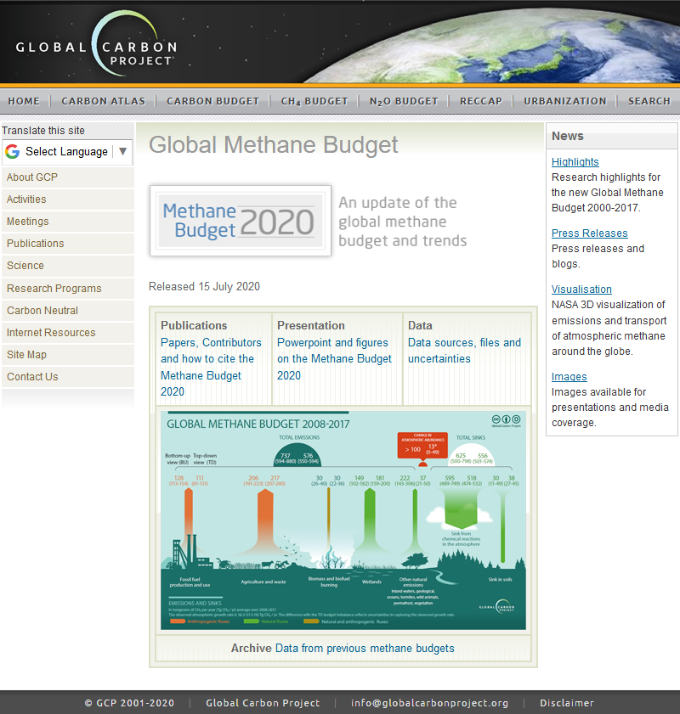
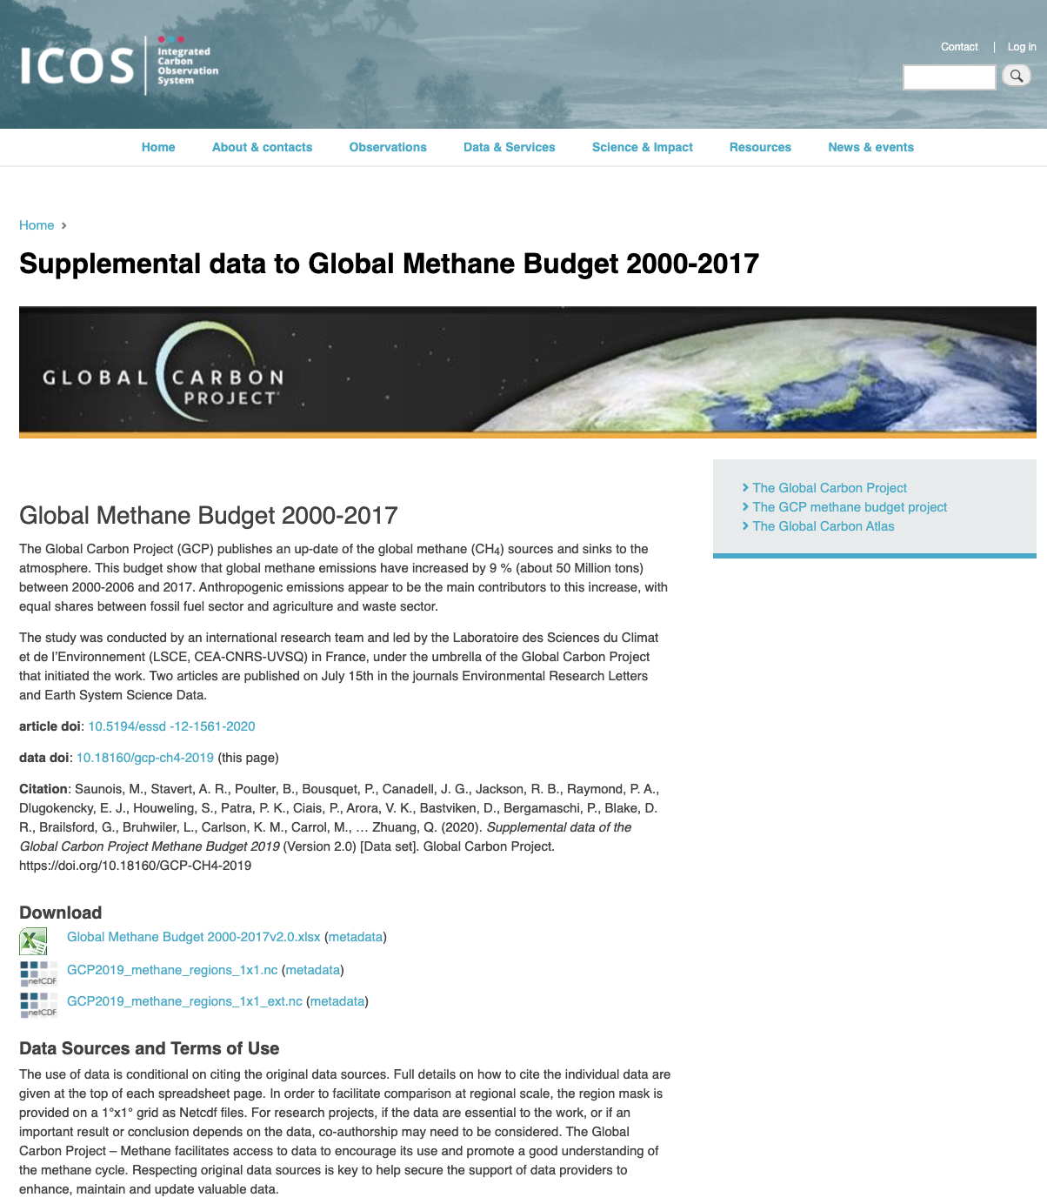
Data access
http://www.globalcarbonproject.org/methanebudget
https://www.icos-cp.eu/GCP-CH4/2019

Slide 6
Contacts
Global Methane Budget Website http://www.globalcarbonproject.org/methanebudget
Executive Committee | Email
Marielle Saunois | marielle.saunois@lsce.ipsl.fr
Philippe Bousquet | philippe.bousquet@lsce.ipsl.fr
Rob Jackson | rob.jackson@stanford.edu
Ben Poulter | benjamin.poulter@nasa.gov
Pep Canadell | pep.canadell@csiro.au

Slide 7
All data are shown in
teragrams CH₄ (TgCH₄) for emissions and sinks
parts per billion (ppb) for atmospheric concentrations
1 teragram (Tg) = 1 million tonnes = 1×10¹²g
2.78 Tg CH₄ per ppb
Disclaimer
The Global Methane Budget and the information presented here are intended for those interested in learning about the carbon cycle, and how human activities are changing it. The information contained herein is provided as a public service, with the understanding that the Global Carbon Project team make no warranties, either expressed or implied, concerning the accuracy, completeness, reliability, or suitability of the information.

Slide 8
Context & Methods

Slide 9
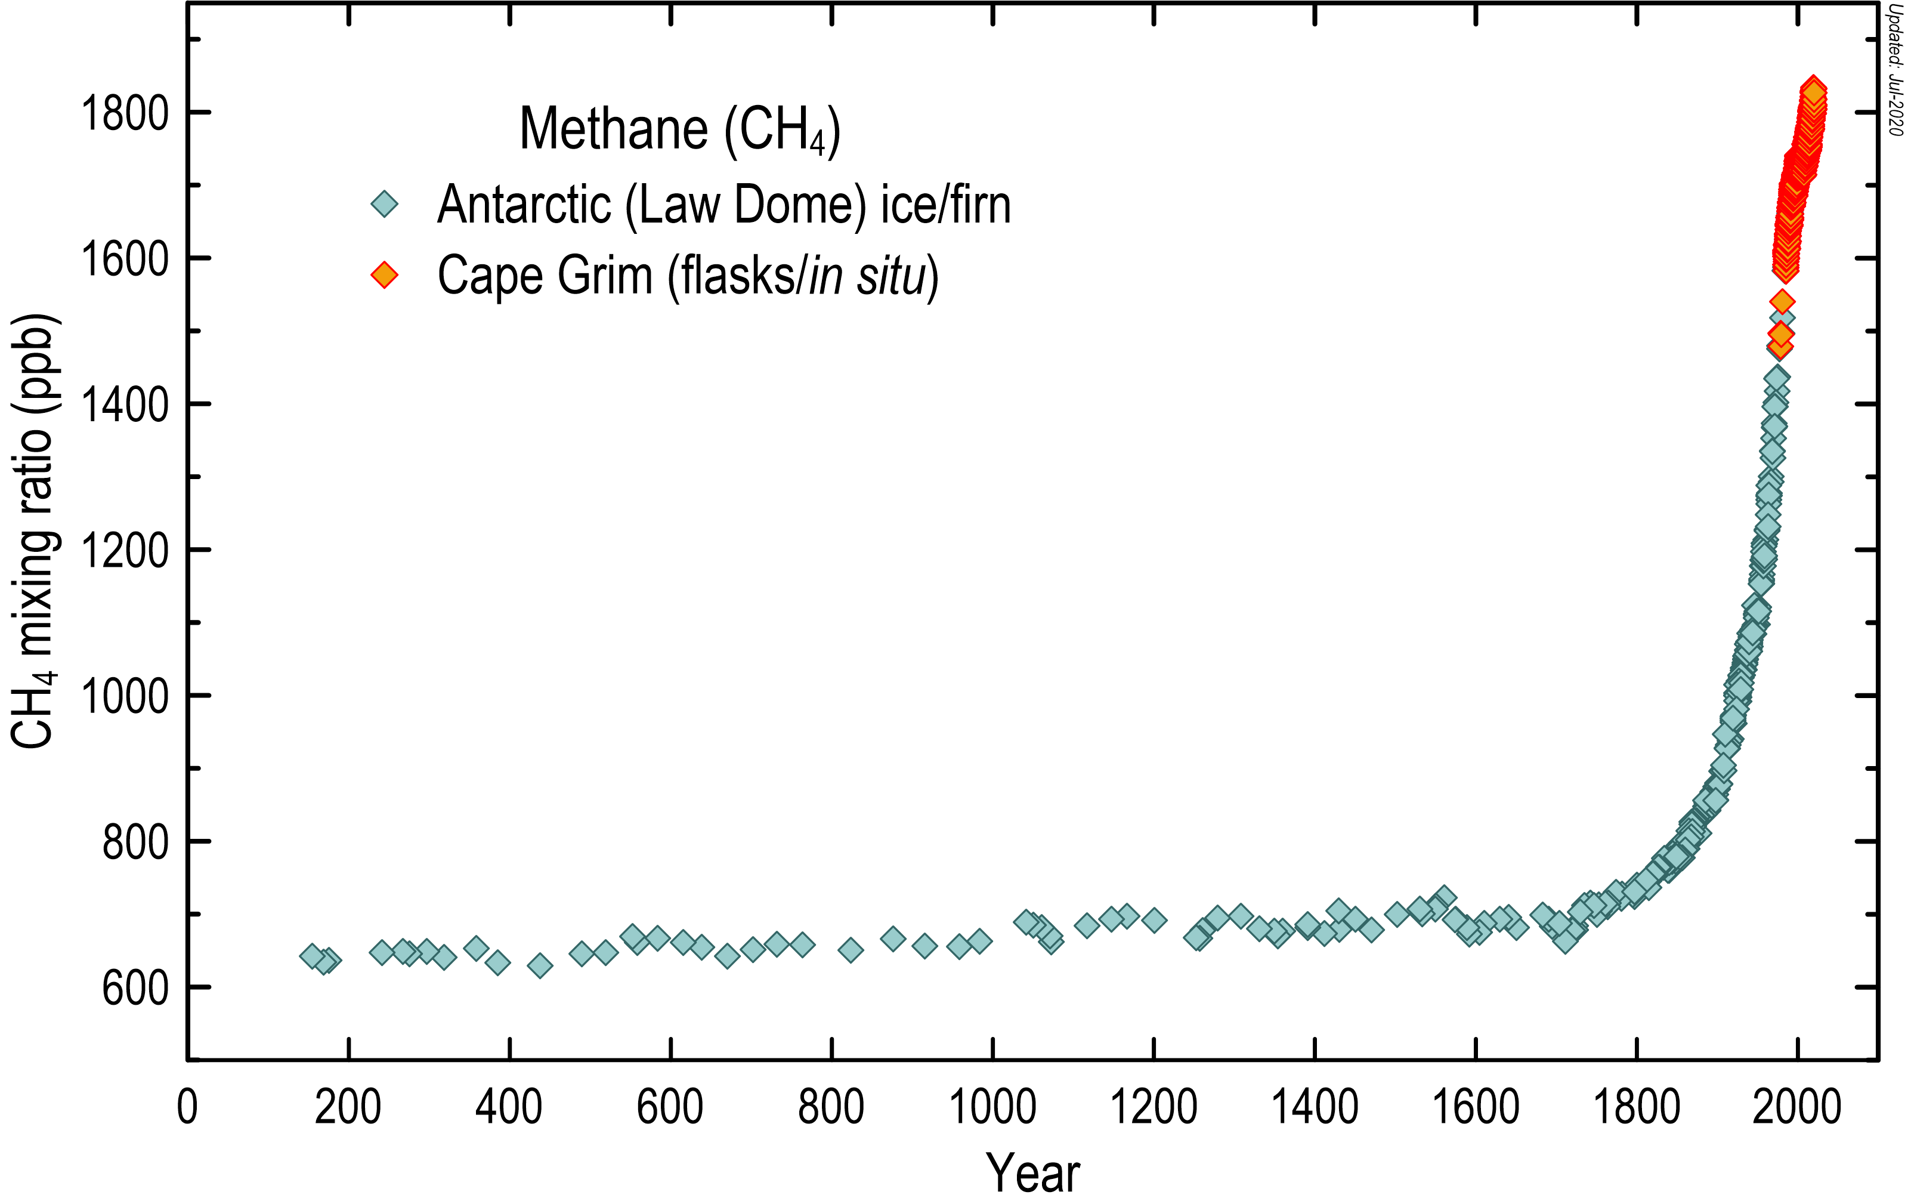
The methane context
After carbon dioxide (CO₂), methane (CH₄) is the most important greenhouse gas contributing to human-induced climate change.
For a time horizon of 100 years, CH₄ has a Global Warming Potential 28 times larger than CO₂.
Methane is responsible for 23% of the global warming produced by CO_{2,} CH₄ and N₂O.
The concentration of CH₄ in the atmosphere is 150% above pre-industrial levels (cf. 1750).
The atmospheric lifetime of CH₄ is 9±2 years, making it a good target for climate change mitigation
Etheridge et al., JGR, 1996; 1998
MacFarling Meure et al., GRL, 2006
Rubino et al., ESSD, 2019
Updated to 2020
Methane also contributes to tropospheric production of ozone, a pollutant that harms human health, foof production and ecosystems.
Methane also leads to production of water vapor in the stratosphere by chemical reactions, enhancing global warming.
Sources : Saunois et al. 2016; 2020, ESSD; IPCC 2013 5AR; Etminan et al. 2016

Slide 10
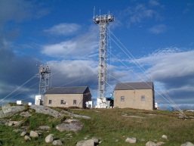



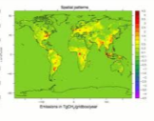
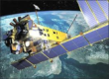
An ensemble of tools and data to estimate the global methane budget
Bottom-up budget
Atmospheric observations
Emission inventories
Biogeochemistry models & data-driven methods
Methane sinks
Inverse models
Top-down budget
Ground-based data from observation networks (AGAGE, CSIRO, NOAA, UCI, LSCE, others).
Satellite data (GOSAT)
Agriculture and waste related emissions, fossil fuel emissions (EDGARv4.3.2,CEDS, USEPA, GAINS, FAO).
Fire emissions (GFED4s, FINN, GFAS,QFED, FAO).
Biofuel estimates
Ensemble of 13 wetland models
Model for termites emissions
Other sources from literature (inland water, geological, wild animal…)
OH sink from CCMI experiment.
Soil uptake & chlorine sink taken from the literature
Suite of 9 atmospheric inversion models (CTE-CH₄, GELCA, PYVAR-LMDz, MIRO4-ACTM, NICAM-TM, NIES-TM FLEXPART, TM5-CAMS, TM5-4DVAR-NIES, TOMCAT).
Ensemble of 22 inversions (diff. obs & setup)

Slide 11
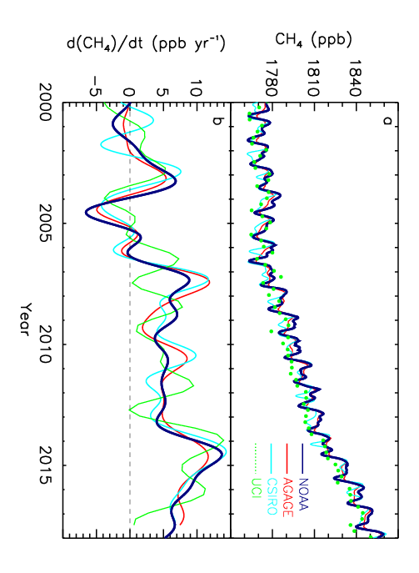
CH₄ Atmospheric Growth Rate 2000-2017
Slowdown of atmospheric growth rate before 2006
Resumed increase after 2006
Atmospheric observations
Source: Saunois et al. 2020, ESSD (Fig. 1)

Slide 12
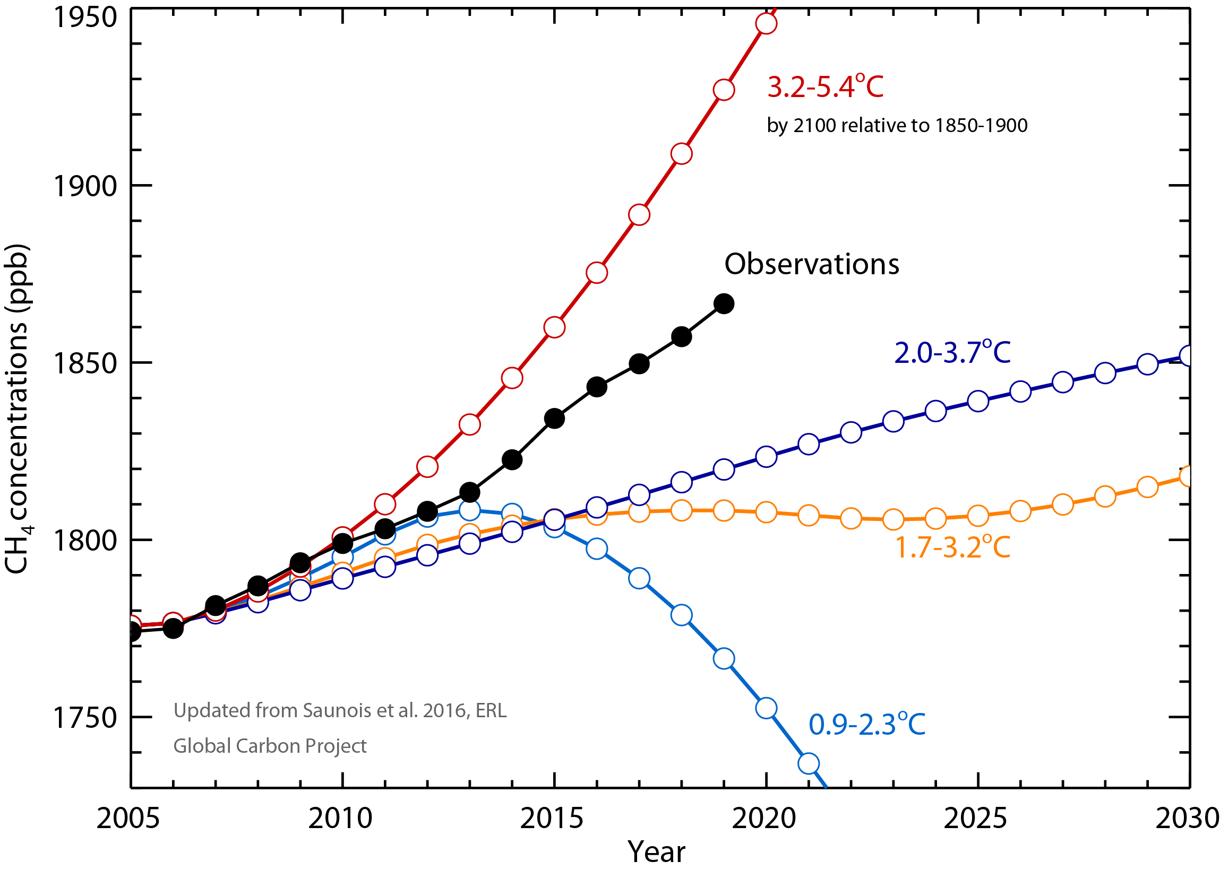
Observed Concentrations Compared to IPCC Projections
The projections represented here correspond to RCPs defined for IPCC 5th Assessment Report
Observations: Globally averaged marine surface annual mean data from NOAA
Methane concentrations rose faster in 2014, 2015 and 2019 with more than 10 ppb/yr.
Since 2013, the atmospheric increase is approaching the warmest scenario of IPCC AR5 report

Slide 13
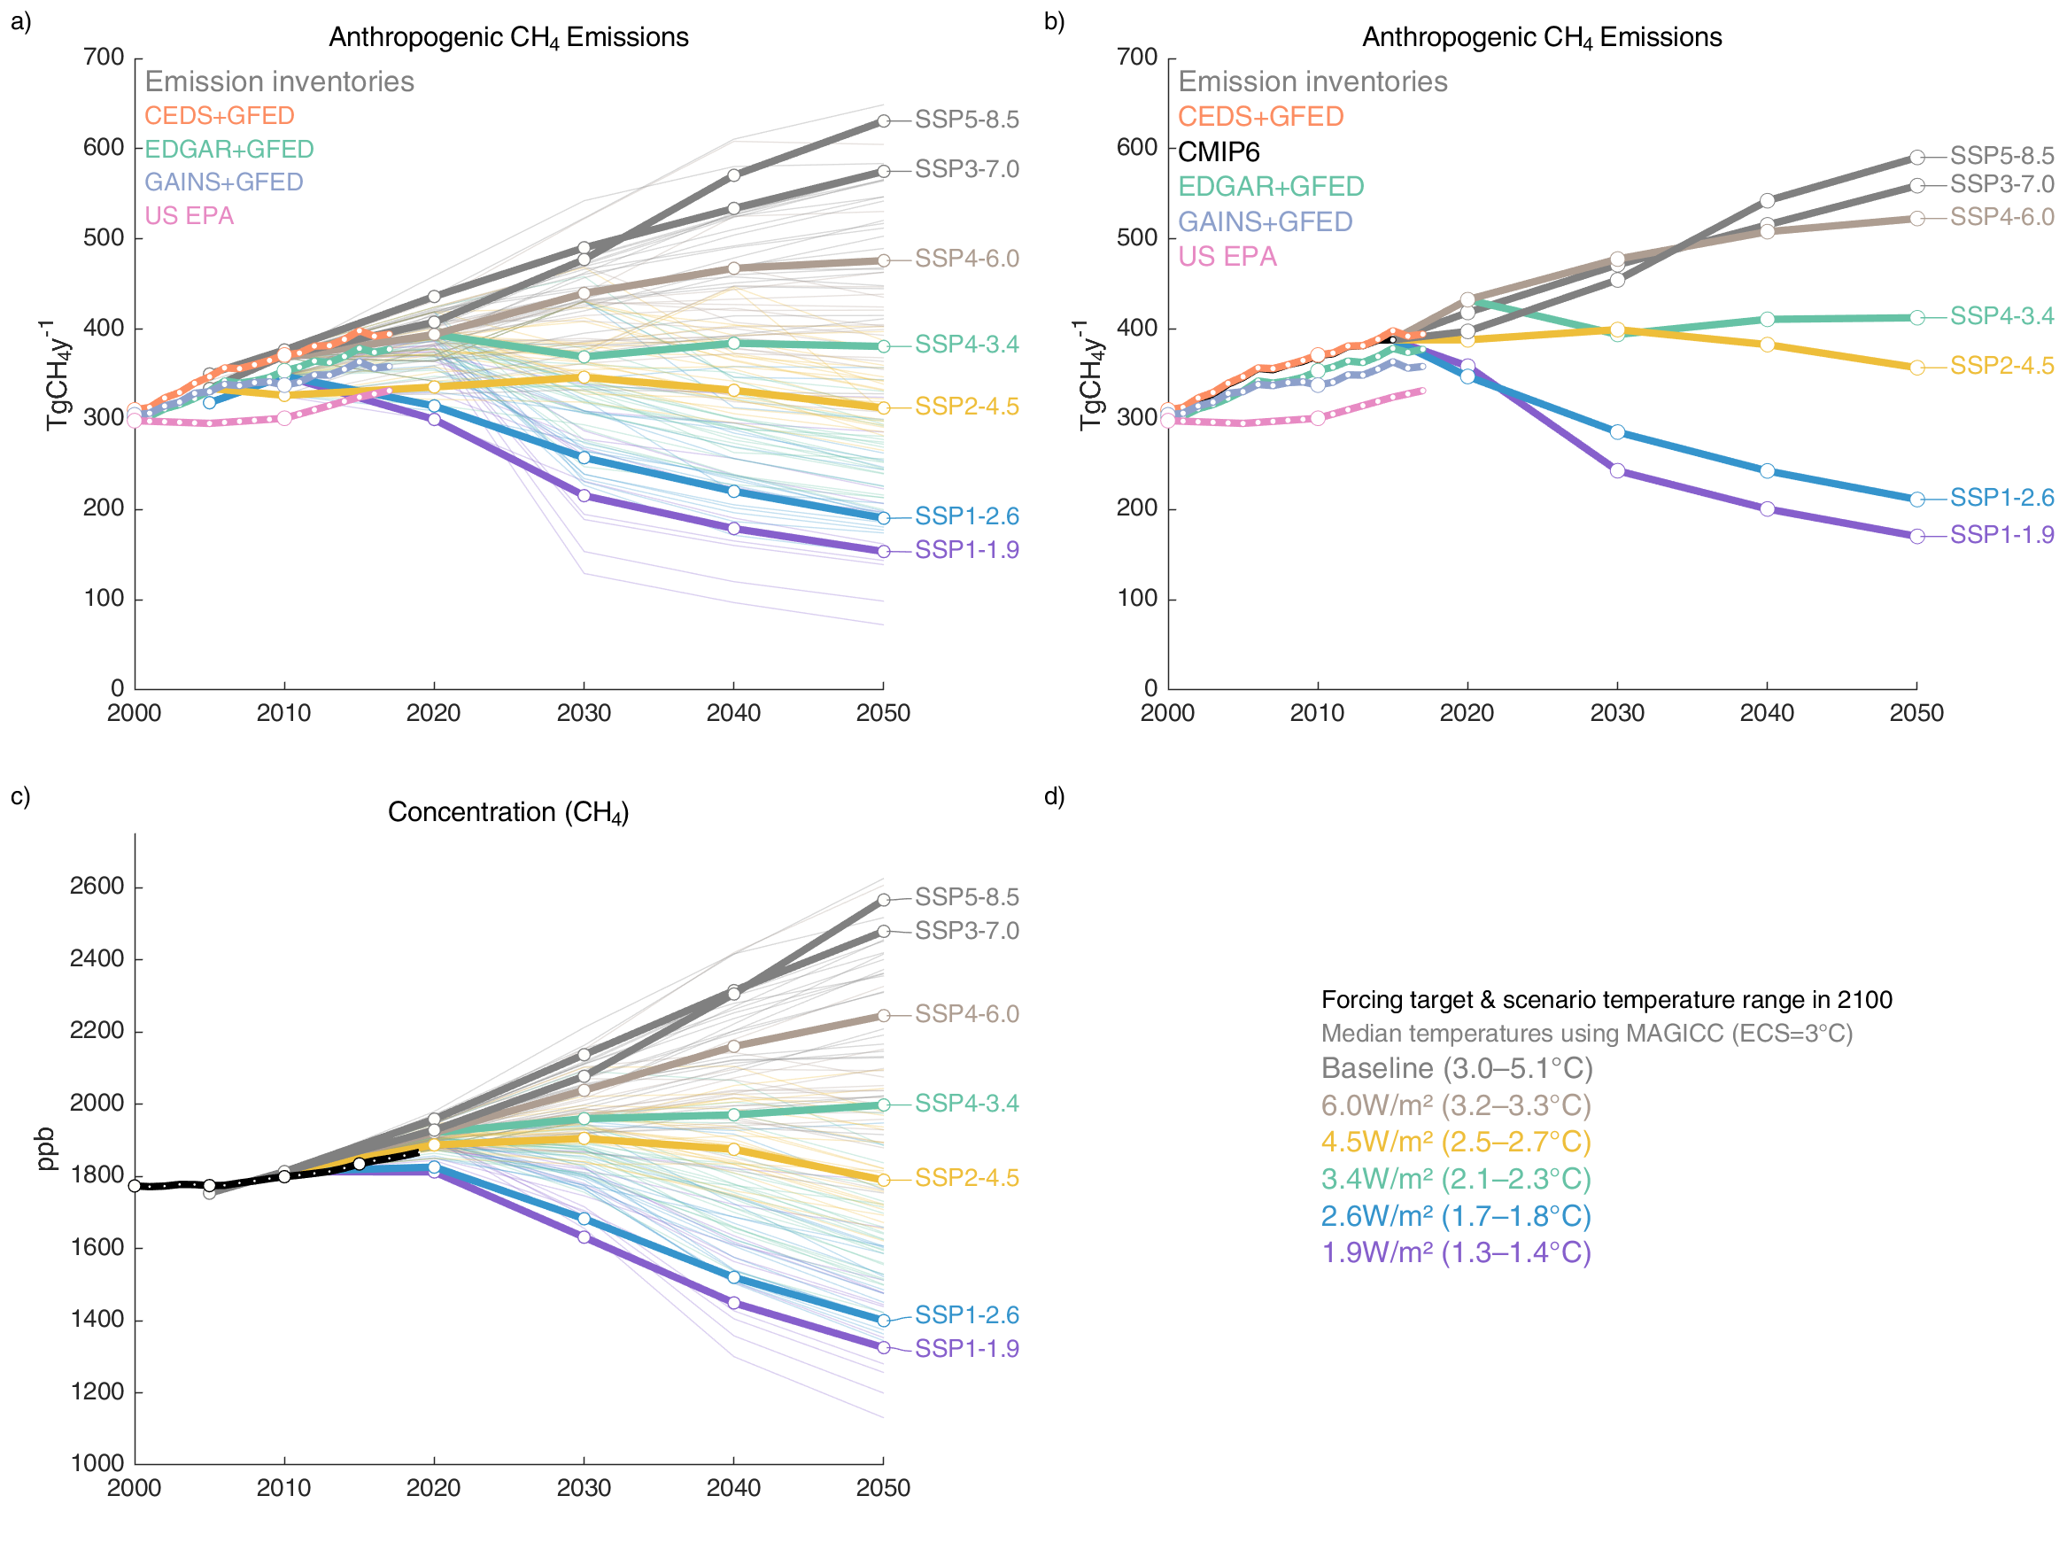
Anthropogenic Methane Emissions & Socioeconomic Pathways (SSPs)
The projections represented here correspond to SSPs defined for IPCC 6th Assessment Report
Anthropogenic emissions:
All inventories, except EPA, infers an increase in emissions as fast as the warmest scenarios between 2005 and 2017.
Atmospheric observations
Emission inventories
Source: Saunois et al. 2020, ESSD (Fig. 2)

Slide 14
Methane Concentrations & Socioeconomic Pathways (SSPs)
The projections represented here correspond to SSPs defined for IPCC 6th Assessment Report
Atmospheric concentrations:
Atmospheric observations (black line) fall between the estimates of the different scenarios
=> Monitoring of future years trends in emissions and concentration is critical to assess mitigation policy efficiency
Atmospheric observations
Emission inventories
Source: Saunois et al. 2020, ESSD (Fig. 2)

Slide 15
Decadal emissions
& sinks

Slide 16
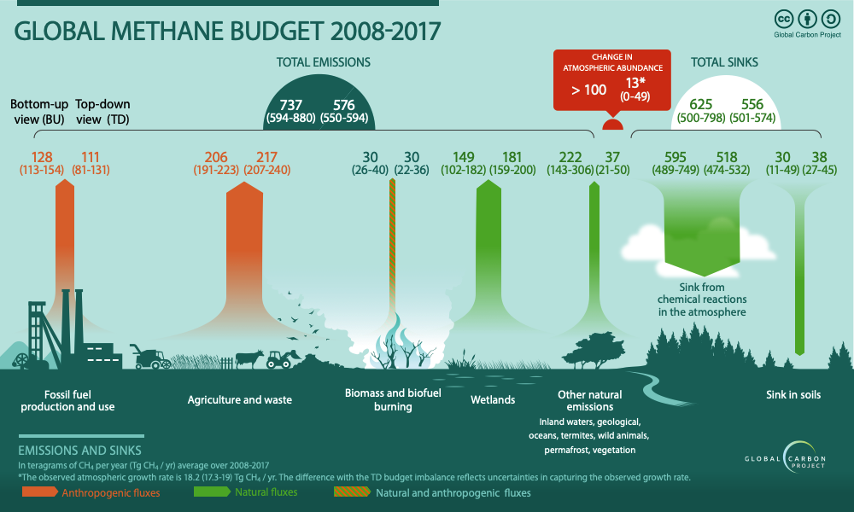
Global Methane Budget 2008-2017
Source: Saunois et al. 2020, ESSD (Fig. 6)

Slide 17
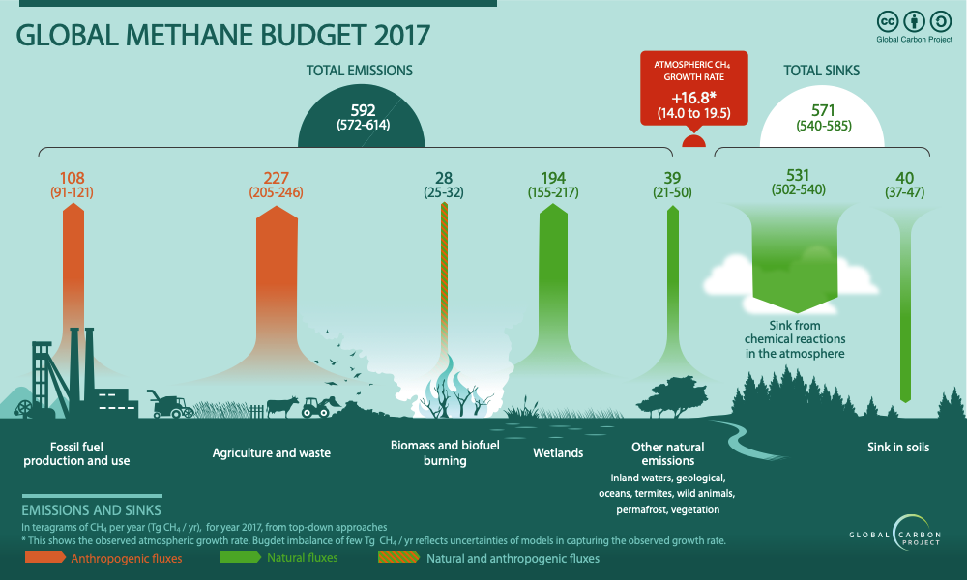
Global Methane Budget 2017
Top-down
budget
Source: Jackson et al. 2020, ERL (Fig. 1)

Slide 18
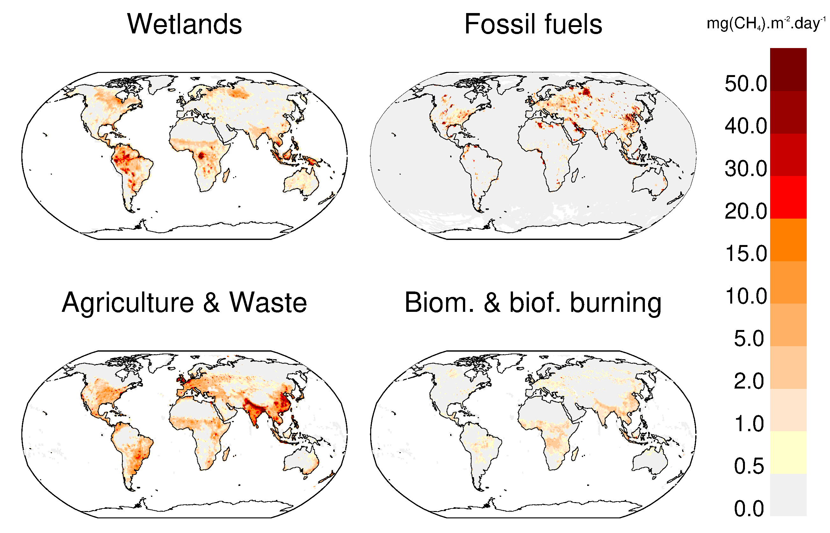

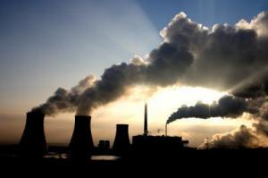
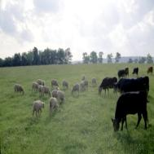
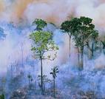
Mapping of the largest methane source categories
Bottom-up
budget
Emission inventories
Biogeochemistry models & data-driven methods
Source: Saunois et al. 2020, ESSD (Fig 3);

Slide 19
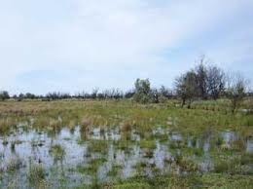
Wetland methane emissions
Bottom-up
budget
Wetlands are the largest natural global CH₄ source
Vegetated wetland emissions are estimated using an ensemble of land-surface models constrained with remote-sensing based surface water and inventory based vegetated wetlands
The resulting global flux range for natural wetland emissions is 102–182 TgCH₄/yr for the decade of 2008–2017, with an average of 149 TgCH4/yr.
Biogeochemistry models & data-driven methods
Source: Saunois et al. 2020, ESSD

Slide 20

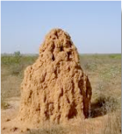
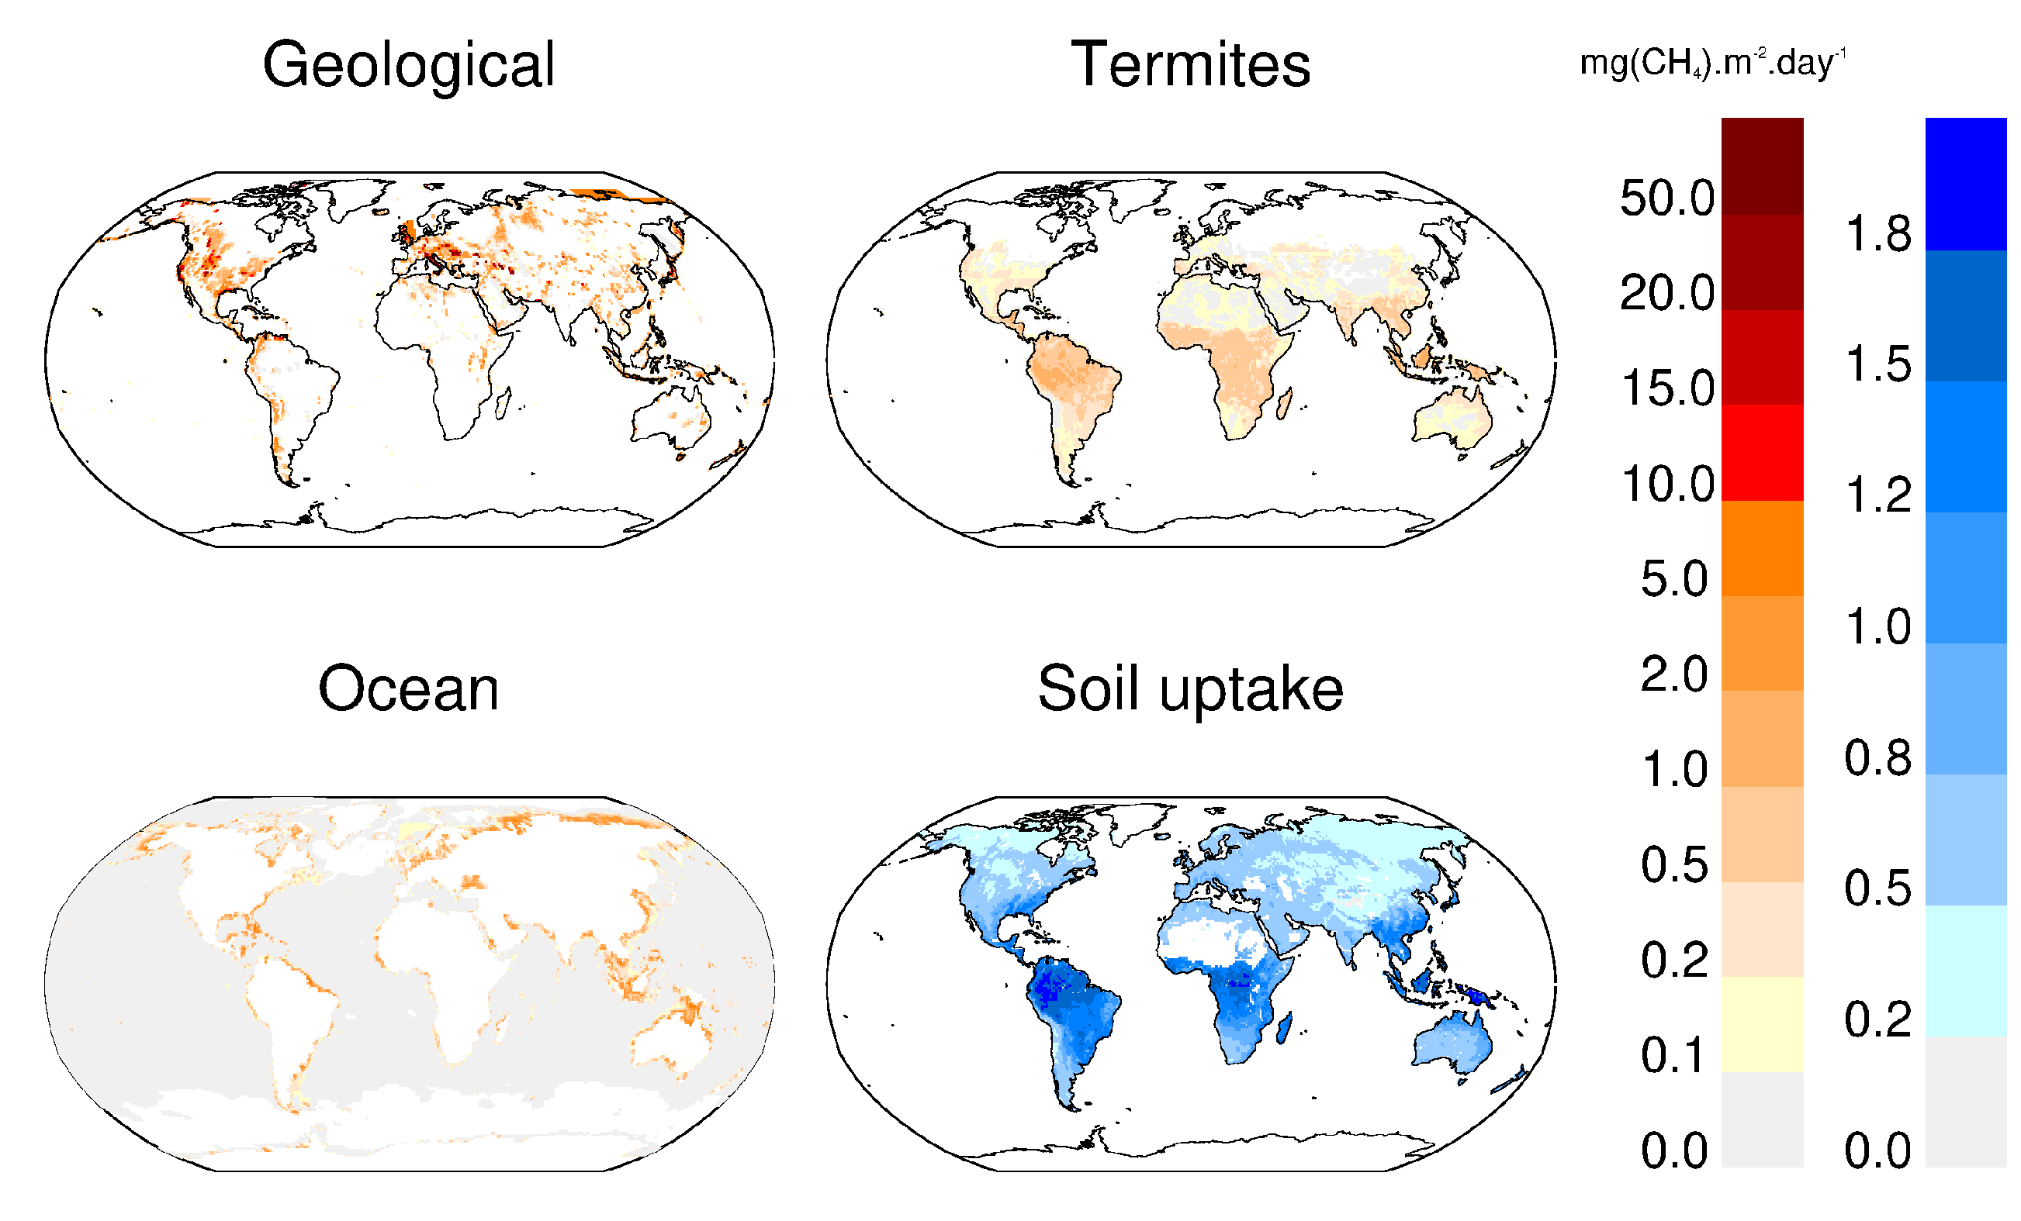

Mapping other natural sources
Bottom-up
budget
Other natural sources not mapped here are inland water emissions, permafrost and hydrates
Biogeochemistry models & data-driven methods
Source: Saunois et al. 2020 (Fig 4)

Slide 21


Methane Sinks (2000s)
Bottom-up
budget
Methane sinks
Source : Saunois et al., 2020

Slide 22
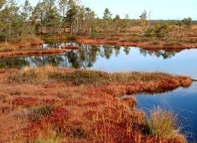

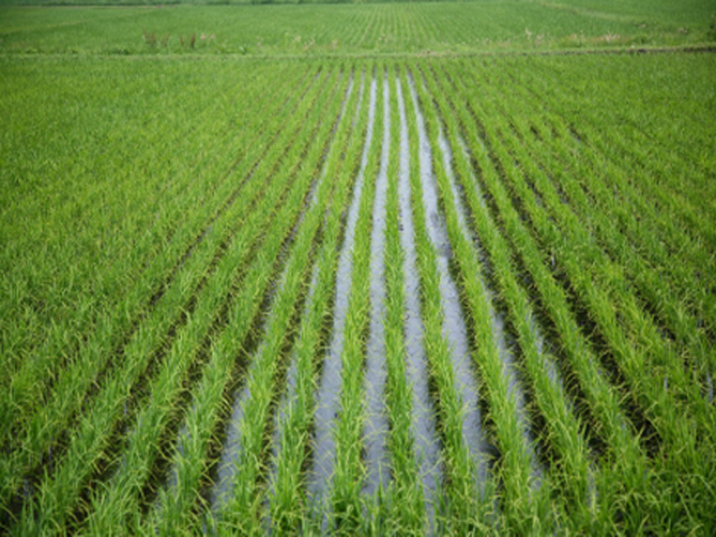
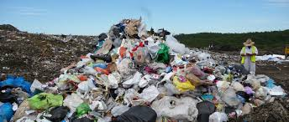
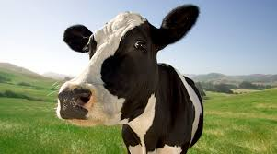
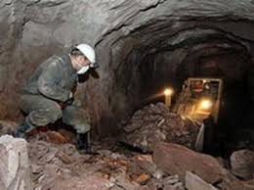
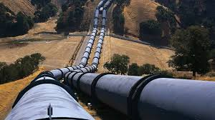
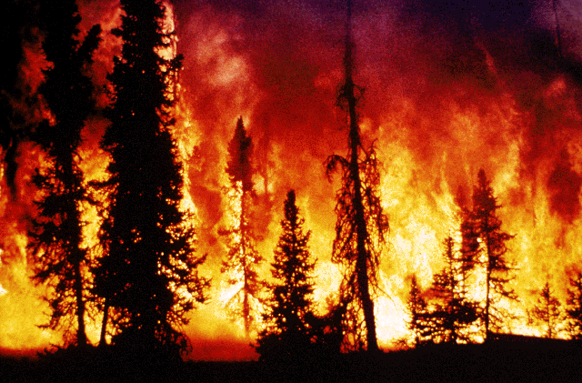

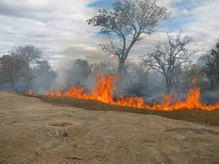
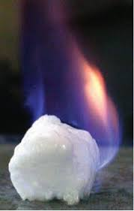
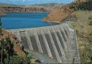

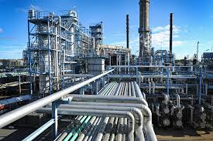
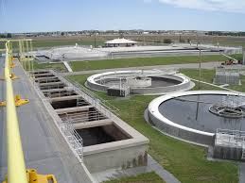
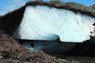
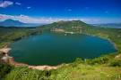
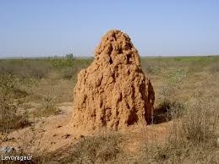
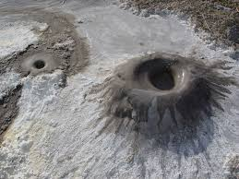
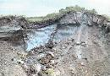
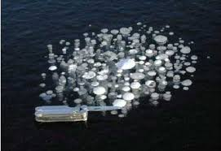
Global Methane Emissions 2008-2017
Bottom-up budget
(TgCH₄/yr)
Top-down budget
149 [50%]
⬅ Natural wetlands ➔
181 [20%]
206 [15%]
⬅ Agriculture & waste ➔
217 [15%]
Rice 30 [40%]
Enteric ferm & manure 111 [10%]
Landfills & waste 65 [15%]
128 [30%]
⬅ Fossil fuel ➔
111 [50%]
Coal 42 [80%]
Gas & oil 80 [30%]
Industry and transport 7 [250 %]
30 [30%]
⬅Biomass/biofuel burning➔
30 [50%]
222 [70%]
⬅Other natural emissions➔
37 [80%]
Inland waters 209 [70%]
Geological 45 [100%]
Termites 9 [100%]
Oceans 6 [100%]
Wild animals 2 [100%]
Permafrost 1 [100%]
Mean [uncertainty=
min-max range %]
Mean [uncertainty = min-max range %]
Bottom-up budget
Process models, inventories, data driven methods
737 TgCH₄/yr [584-881]
Top-down budget
Atmospheric inversions
576 TgCH₄/yr [550-594]
Bottom-up budget
Top-down budget
Mean [min-max range %]
Source : Saunois et al. 2020, ESSD

Slide 23
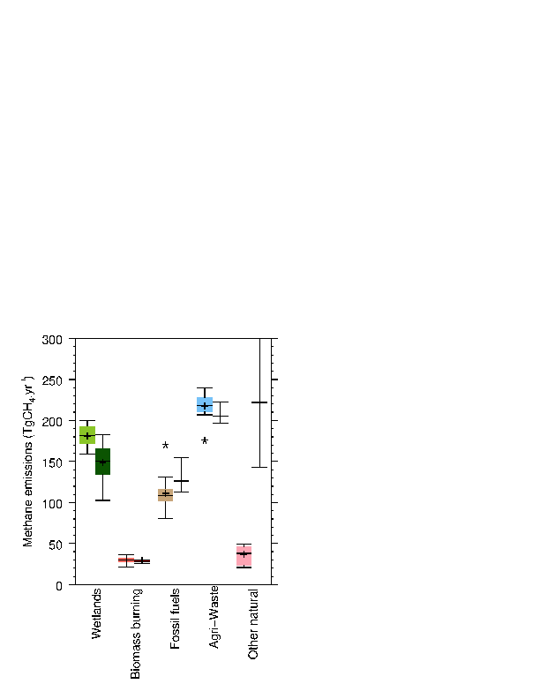
Global Methane Emissions 2008-2017
Top-down, left; Bottom-up, right
Global emissions:
576 TgCH₄/yr [550-594] for TD
737 TgCH₄/yr [594-881] for BU
TD and BU estimates generally agree for agricultural emissions
Estimated fossil fuel emissions are lower for TD than for BU approaches
Estimated wetland emissions are higher for TD than for BU approaches
Large discrepancy between TD and BU estimates for freshwaters and natural geological sources (“other natural sources”)
Source: Saunois et al. 2020, ESSD (Fig 5)
Emission inventories
Biogeochemistry models & data-driven methods
Inverse models

Slide 24
Methane emissions by latitudinal bands 2008-2017
Contribution to global emissions
Source: Saunois et al. 2020, ESSD (Fig 7)
Emission inventories
Biogeochemistry models & data-driven methods
Inverse models

Slide 25
Regional Methane Sources (2017)
Top-down
budget
64% of global methane emissions come mostly from tropical sources
Anthropogenic sources are responsible for about 60% of global emissions.
Largest emissions in South America, Africa, South-East Asia and China (50% of global emissions)
Dominance of wetland emissions in the tropics and boreal regions
Dominance of agriculture & waste in Asia
Balance between agriculture & waste and fossil fuels at mid-latitudes
Inverse models
Source: Jackson et al. 2020 ERL (Fig 2)

Slide 26
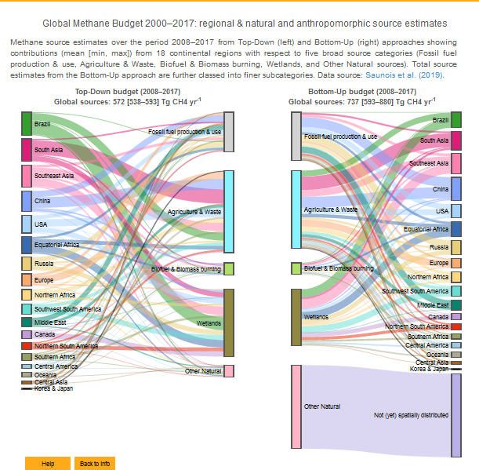
An interactive view of the methane budget
Source: Carbon Atlas
www.globalcarbonatlas.org
Emission inventories
Biogeochemistry models & data-driven methods
Inverse models

Slide 27
Emission
changes

Slide 28
Changes in Methane Sources
Emission changes between 2000-2006 and 2017
Top-down, left; Bottom-up, right
Error bar = min-max estimates
Source: Jackson et al. 2020 ERL (Fig 2)
About 50 TgCH₄/yr emissions increase between 2000-2006 and 2017
Increase mainly from the Tropics (about 30 TgCH₄/yr), followed by mid-latitudes (15-20 TgCH₄/yr )
Regional contributions from Africa and Middle East, China and rest of Asia
Increase in North America driven by the increase from USA
Decrease in Europe
Emission inventories
Biogeochemistry models & data-driven methods
Inverse models

Slide 29
Changes in Methane Sources
Top-down
budget
Emission changes between 2000-2006 and 2017
Top-down, left; Bottom-up, right
Global increase mainly from anthropogenic sources equally between Agriculture and Waste and Fossil Fuel
Fossil Fuel emissions increased in China, North America (USA), Africa, and Asia
Agriculture and Waste emissions increased mostly in Africa, Southern Asia and South America
Emissions decreased in Europe from both Fossil Fuel and Agriculture and Waste sources
Error bar = min-max estimates
Source: Jackson et al. 2020 ERL (Fig 2)
Emission inventories
Biogeochemistry models & data-driven methods
Inverse models

Slide 30
Sink
changes

Slide 31
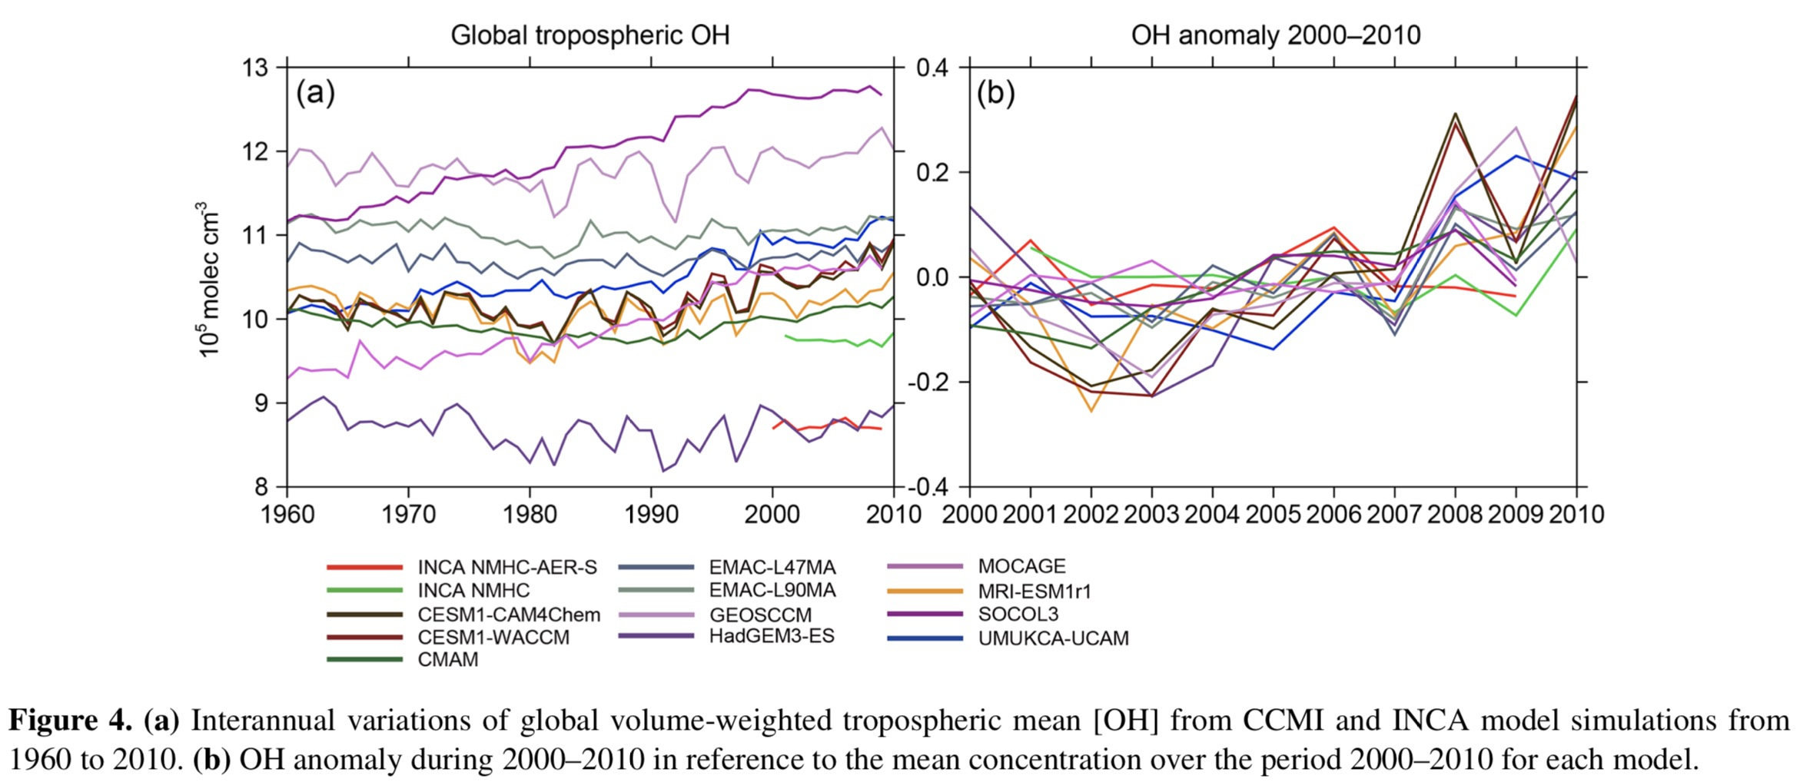
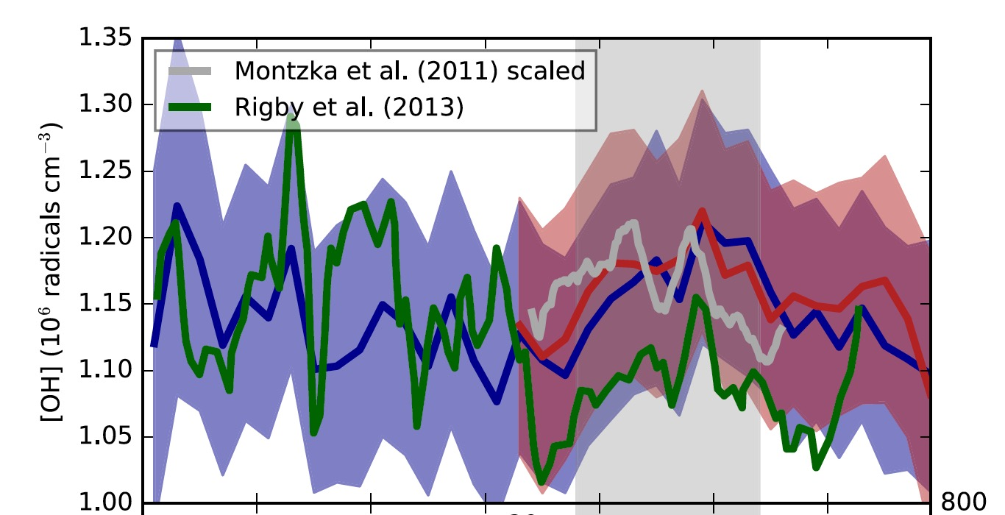
Concentrations of OH the troposphere
Hydroxyl radical, OH is the main oxidant of CH₄, responsible of about 90% of methane removal in the atmosphere.
Two approaches derive estimates of OH quantity in the atmosphere:
Chemistry climate models that includes hundreds chemical reactions between numerous species
Box-modeling based on methyl-chloroform (MCF) observations
Both approaches derive a 10-15% uncertainty on global OH mean concentrations.
Chemistry Climate models
MCF-based box modelling
AGAGE
NOAA
Source: Zhao et al. 2019
Source: Rigby et al. 2017

Slide 32
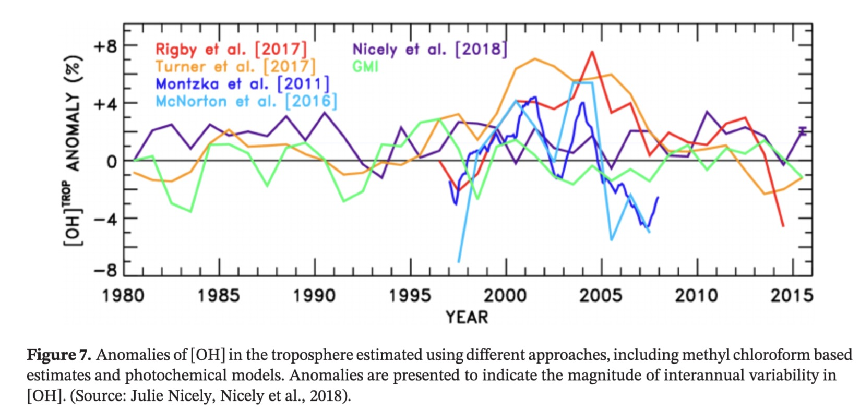
OH inter-annual variability and trend
Chemistry climate models derive a null to positive trend in OH over 2000-2017
MCF-based box modelling suggest a positive trend in OH over 1997-2005 followed by a negative trend from 2005 onward
High uncertainty remains on OH trend and interannual variability
Chemistry climate models
MCF-based box modelling versus chemistry climate models
OH anomaly 1980-2015
MCF-based studies
Chemistry climate models
Source: Zhao et al. 2019
Source: Ganesan et al. 2020

Slide 33
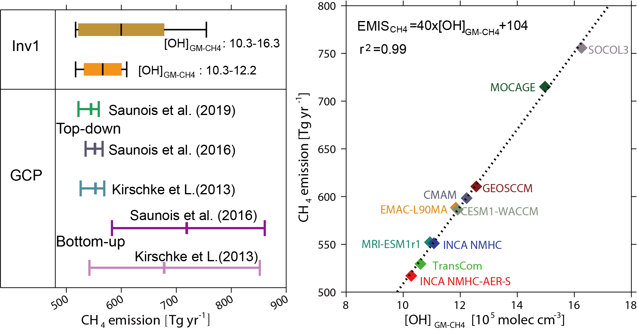
OH uncertainty & impact on CH₄ emissions
Estimated CH₄ total emissions in year 2001 by one single top-down system using different OH distributions
Top-Down estimates
for 2000-2009
Saunois et al. (2020)
Source: Zhao et al. 2020, ACP
Methane emissions derived by top-down systems are dependent of the OH sink prescribed
The range derived by an ensemble of top-down approaches in Saunois et al. (2020) is narrower than the one derived by a single top-down system when testing several OH distributions (from chemistry climate models)
The uncertainty in global total methane emissions is probably underestimated in Saunois et al. (2020)

Slide 34
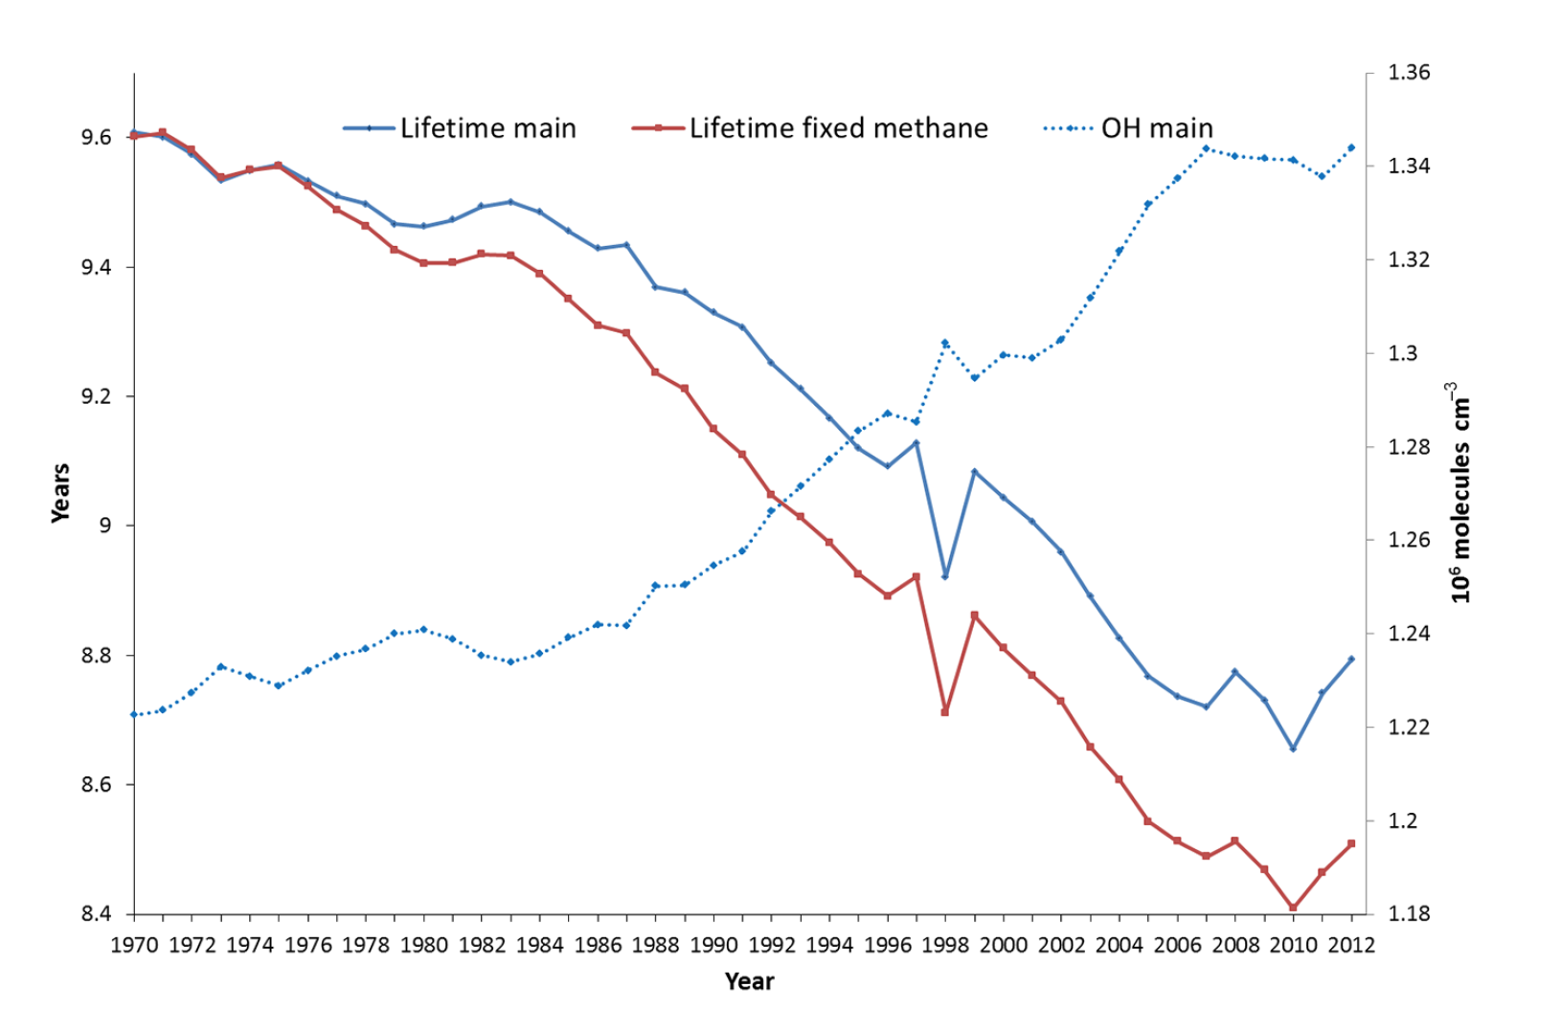
Impact of OH change in the methane sink
OH increase before 2007 could explain part of the stabilization of atmospheric methane
Stagnation or decrease in OH radicals can contribute to explain :
the renewed increase of atmospheric methane since 2007
The lighter atmosphere in ¹³C isotope since 2007
Stabilisation
Source : Dalsoren et al., 2016

Slide 35
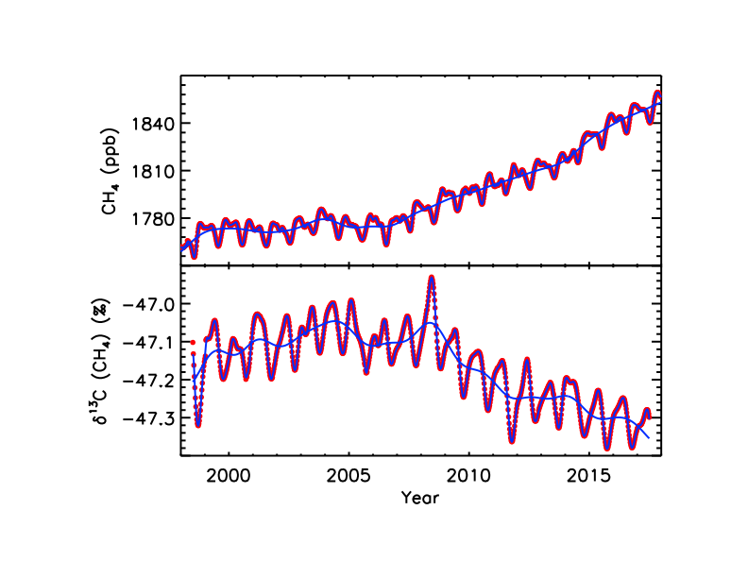
Since 2007: a sustained atmospheric CH₄ growth and δ¹³C-CH₄ decrease
NOAA Global surface CH₄
1867 ppb reached in 2019 !
CH₄ Growth rates :
2014 : 12.7±0.5 ppb yr⁻¹
2015 : 10.1±0.7 ppb yr⁻¹
: 7.0±0.6 ppb yr ⁻¹
: 7.0±0.9 ppb yr⁻¹
: 8.5±0.6 ppb yr⁻¹
: 10.7±0.6 ppb yr⁻¹
δ¹³C-CH₄ decreased by -0.2‰ in 10 years
Renewed growth
Stabilisation
Decline
Global surface δ¹³C-CH₄
Source : Nisbet et al., 2019
Need to understand which changes in emissions are responsible for both increasing atmospheric methane and decreasing δ¹³C-CH₄ since 2007

Slide 36
Highlights
Atmospheric CH₄ concentrations are rising faster over the last decades than in the 2000s. Since 2013, the trend in atmospheric methane concentrations is closer to the most greenhouse-gas-intensive scenarios of IPCC AR5 than scenarios integrating mitigation policies.
Anthropogenic sources are responsible for all or most of the recent rapid rise in global CH₄ concentrations, equally from agriculture and fossil fuels sources. Tropical regions play the most significant role as contributors to the atmospheric growth.
The role of methane sinks has to be further explored as a slower destruction of methane by OH radicals in the atmosphere could have also contributed to the observed atmospheric changes of the past decade. However high uncertainties on OH burden and trend prevent any solid conclusions.
Methane global emissions were 576 TgCH₄/yr [550-594] for 2008-2017 as inferred by an ensemble of atmospheric inversions (top-down approach) using an atmospheric constraint.
Methane mitigation offers rapid climate benefits and economic, health and agricultural co-benefits that are highly complementary to CO₂ mitigation.
Emission estimates from inventories/models (bottom-up approach) show larger global totals because of larger natural emissions. Improved emission inventories and estimates from inland water emissions are still needed.

Slide 37
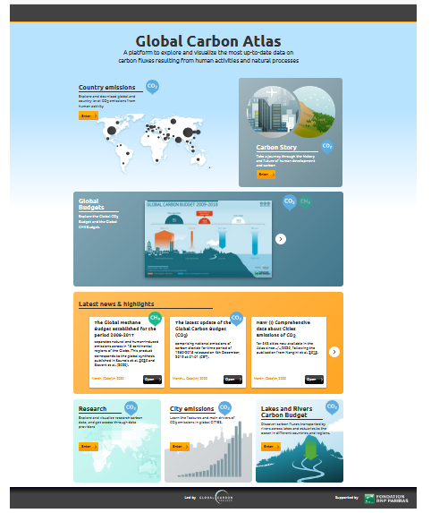
Global Carbon Atlas
Explore GHG emissions globally and by country and download data and illustrations. Also explore ‘Outreach’ and ‘Research’.
www.globalcarbonatlas.org

Slide 38

NASA 3D visualization
The methane budget, using data from Saunois 2020, can be visualized in 3D at: https://svs.gsfc.nasa.gov/4799

Slide 39











Acknowledgements
The work presented in the Global Methane Budget 2020 has been possible thanks to the contributions of hundreds of people involved in observational networks, modeling, and synthesis efforts. Not all of them are individually acknowledged in this presentation for reasons of space (see slide 3 for those individuals directly involved).
Additional acknowledgement is owed to those institutions and agencies that provide support for individuals and funding that enable the collaborative effort of bringing all components together in the carbon budget effort.
NIES GOSAT project, GOSAT Research Computation Facility, National Aeronautic and Space Administration (NASA), Swedish National Infrastructure for Computing, ARC Linkage project, LSCE computing resources, ECMWF computing resources, European Commission Seventh Framework, Horizon2020, and ERC programme, ESA Climate Change Initiative Greenhouse Gases project, FRS-FNRS Belgium program, German federal Ministry of Education and Research, Gordon and Betty Moore foundation, Linköping University, US Department of Energy, Japanese Ministry of the Environment, Japanese Aerospace Exploration Agency, National Institute for Environmental Studies, all FAO member countries, Swedish Research Council, Ministry of the Environment (Japan), National Science Engineering Research Council of Canada, Commonwealth Scientific and Industrial Research Organization (CSIRO Australia), Australian Government Bureau of Meteorology, Australian Institute of Marine Science, Australian Antarctic Division, Australian Department of the Environment and Energy, Refrigerant Reclaim Australia, Australian National Environmental Science Program-Earth Systems and Climate Hub, NOAA USA, Meteorological Service of Canada, Met Office Climate Science for Service Partnership Brazil, UK Department for Business, Energy and industrial strategy
We also thank the sponsors of the GCP and GCP support/liaison offices

Slide 40

Creative Commons
Attribution 4.0 International (CC BY 4.0)
This deed highlights only some of the key features and terms of the actual license. It is not a license and has no legal value. You should carefully review all of the terms and conditions of the actual license before using the licensed material. Creative Commons is not a law firm and does not provide legal services. Distributing, displaying, or linking to this deed or the license that it summarizes does not create a lawyer-client or any other relationship. This is a human-readable summary of (and not a substitute for) the license.
You are free to:
Share — copy and redistribute the material in any medium or format
Adapt — remix, transform, and build upon the material
The licensor cannot revoke these freedoms as long as you follow the license terms.
Under the following terms:
Attribution — You must give appropriate credit, provide a link to the license, and indicate if changes were made. You may do so in any reasonable manner, but not in any way that suggests the licensor endorses you or your use. What does "Attribute this work" mean? The page you came from contained embedded licensing metadata, including how the creator wishes to be attributed for re-use. You can use the HTML here to cite the work. Doing so will also include metadata on your page so that others can find the original work as well.
No additional restrictions — You may not apply legal terms or technological measures that legally restrict others from doing anything the license permits.
You do not have to comply with the license for elements of the material in the public domain or where your use is permitted by an applicable exception or limitation.
No warranties are given. The license may not give you all of the permissions necessary for your intended use. For example, other rights such as publicity, privacy, or moral rights may limit how you use the material.

Slide 41
References used in this presentation
Global Methane Budget 2000-2017, data sources and data files at http://www.globalcarbonproject.org/methanebudget/
Saunois M. et al. (2020): The Global Methane Budget 2000-2017, Earth System Science Data, https://doi.org/10.5194/essd-12-1561-2020
Jackson R. B. et al. (2020) Increasing Anthropogenic Methane Emissions Arise Equally from Agricultural and Fossil Fuel Sources. Environmental Research Letters, https://doi.org/10.1088/1748-9326/ab9ed2
Dalsoren et al. (2016): Atmospheric methane evolution the last 40 years, Atmos. Chem. Phys., 16,3099-3126, http://dx.doi.org/10.5094 acp-16-3099-2016
Ganesan A. L. et al. (2020): Advancing Scientific Understanding of the Global Methane Budget in Support of the Paris Agreement, https://doi.org/10.1029/2018GB006065
IPCC (2013) WGI. 5th Assessment Report. Intergovernmental Panel on Climate Change. Cambridge University Press, Cambridge, United Kingdom and New York, NY, USA.
Kirschke, S. et al. (2013): Three decades of global methane sources and sinks. Nature Climate Change, 6, 813-823, http://dx.doi.org/10.1038ngeo1955
Nisbet E. et al. (2019): Very Strong Atmospheric Methane Growth in the 4 Years 2014–2017: Implications for the Paris Agreement, https://doi.org/10.1029/2018GB006009, 2019
Rigby M. et al. (2017): Role of atmospheric oxidation in recent methane growth, Proc. Natl. Acad. Sci., 114(21), 5373, https://doi.org/10.1073/pnas.1616426114, 2017.
Saunois, M. et al. (2016): The Global Methane Budget 2000-2012, Earth System Science Data, 8, 1-54, http://dx.doi.org/10.5194/essd-8-1-2016
Saunois M. et al. (2016): The growing role of methane in anthropogenic climate change. Environmental Research Letters, vol. 11, 120207, DOI: 10.1088/1748-9326/11/12/120207. http://iopscience.iop.org/article/10.1088/1748-9326/11/12/120207
Zhao Y. et al. (2019): Inter-model comparison of global hydroxyl radical (OH) distributions and their impact on atmospheric methane over the 2000–2016 period, Atmos. Chem. Phys., 19, 13701–13723, https://doi.org/10.5194/acp-19-13701-2019, 2019.
Zhao Y. et al. (2020): Influences of hydroxyl radicals (OH) on top-down estimates of the global and regional methane budgets, Atmos. Chem. Phys. Discuss., https://doi.org/10.5194/acp-2019-1208, accepted, 2020.

